Slide 1
DATA MODELS & SQL BASICS
Database Concepts Spring 2021
Week 3

Slide 2
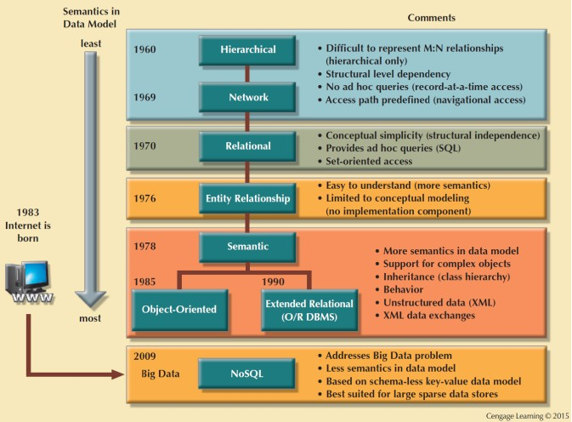
Figure 2.6 - The Evolution of Data Models

Slide 3
Table 2.1 - The Evolution of Data Models
Notes:
The first two Data models ( hierarchical and network DBs ) are not used anymore.
The dominant database model is the relational database model—all current major DBMS products are based on it. It was created by IBM engineer E. F. Codd in 1970.

Slide 4
Hierarchical and Network Models
Hierarchical Models
Data is structured hierarchically and is typically diagrammed as an upside-down tree
Depicts a set of one-to-many (1:M) relationships between a parent and its children segments
Network Models
Represent complex data relationships
Allow a record to have more than one parent
Depicts both one-to-many (1:M) and many-to-many (M:N) relationships
Notes:
The hierarchical model represents a set of one-to-many (1:M) relationships between a parent and its children segments. (Each parent can have many children, but each child has only one parent.)
Unlike the hierarchical model, the network model allows a record to have more than one parent.

Slide 5

Standard Database Concepts
Schema
Conceptual organization of the entire database as viewed by the database administrator
Subschema
Portion of the database seen by the application programs that produce the desired information from the data within the database
Notes:
.

Slide 6


Standard Database Concepts
Data manipulation language (DML)
Defines the environment in which data can be managed and is used to work with the data in the database
Data definition language (DDL)
Enables the database administrator to define the schema components

Slide 7
Relational Model
Based on a relation
Relation or table: Matrix composed of intersecting tuple and attribute
Tuple: Rows
Attribute: Columns
Relational data model is implemented through a relational database management system (RDBMS)
Provides a minimum level of controlled redundancy to eliminate most of the redundancies commonly found in file systems

Slide 8
Relational Model
A relation or table is a two-dimensional table that has the following characteristics:
Rows contain data about an entity.
Columns contain data about attributes of the entity.
All entries in a column are of the same kind.
Each column has a unique name.
Cells of the table hold a single value.
The order of the columns is unimportant.
The order of the rows is unimportant.
No two rows may be identical.

Slide 9
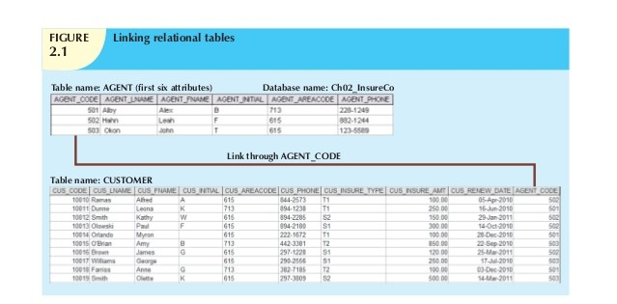
Figure 2.1 – Linking relational tables

Slide 10
Relational Model (Table 2.2)
Advantages
Structural independence is promoted using independent tables
Tabular view improves conceptual simplicity
Ad hoc query capability is based on SQL
Isolates the end user from physical-level details
Improves implementation and management simplicity
Disadvantages
Requires substantial hardware and system software overhead
Conceptual simplicity gives untrained people the tools to use a good system poorly
May promote information problems
Notes:
The most important advantage of the RDBMS is its ability to hide the complexities of the relational model from the user. The RDBMS manages all of the physical details, while the user sees the relational database as a collection of tables in which data is stored.
An ad hoc query is created to obtain information as the need arises.
Ad-hoc queries:
Questions that can be answered using database data
Example: “How many customers in Portland, Oregon, bought our green baseball cap?”

Slide 11
Relational Diagram
A relational diagram is a representation of the relational database’s entities, the attributes within those entities, and the relationships between those entities.

Slide 12
The Entity Relationship Model
Entity relationship diagram (ERD)
Uses graphic representations to model database components
Helps identify the database's main entities and their relationships
Entity: Anything about which data will be collected and stored
Rows in the relational table: Entity instance or entity occurrence
A collection of entity instance: Entity set
Attribute: Describes particular characteristics of an entity
Relationship: Describes associations among entity
Connectivity: Describes the relationship classification
Cardinality: Expresses the minimum and maximum number of entity occurrences associated with one occurrence of related entity
Notes:
ERM form the basis of ERD

Slide 13
The Object-Oriented Data Model (OODM) or Semantic Data Model
Object: Abstraction of real-world entity
Contains data and their relationships with operations that are performed on it (have greater semantic content than an entity)
Similar to an ER model’s entity; More precisely, an object represents only one occurrence of an entity
Attributes: Describe the properties of an object
Implemented through object-oriented database management system (OODBMS)
Notes:
In the object-oriented data model (OODM), both data and their relationships are contained in a single structure known as an object. The OODM is said to be a semantic data model because semantic indicates meaning.
Attributes describe the properties of an object. For example, a PERSON object includes the attributes Name, Social Security Number, and Date of Birth.

Slide 14
The Object-Oriented Data Model (OODM)
Class: Collection of similar objects with shared structure (attribute) and behavior (method)
An object is an instance of a specific class
a class resembles the ER model’s entity set
A class’s method represents a real-world action
Class hierarchy: Resembles an upside-down tree in which each class has only one parent
Inheritance: The ability of an object within the class hierarchy to inherit the attributes of the classes above it
Notes:
Objects that share similar characteristics are grouped in classes.
A class’s method represents a real-world action such as finding a selected PERSON’s name, changing a PERSON’s name, or printing a PERSON’s address.
Classes are organized in a class hierarchy. For example, two classes, CUSTOMER and EMPLOYEE, can be created as subclasses from the class PERSON. In this case, CUSTOMER and EMPLOYEE will inherit all attributes from PERSON.

Slide 15
NoSQL Databases (Chapter 2.5.6)
▪▪ Not based on the relational model
▪▪ Support distributed database architectures
▪▪ Provide high scalability, high availability, and fault tolerance
▪▪ Support large amounts of sparse data
▪▪ Focus on performance rather than transaction consistency
Notes:
NOSQL is a new generation of database management systems that is not based on the traditional relational database model.

Slide 16
NoSQL Databases (Chapter 2.5.6)
Notes:
The key-value data model is based on a structure composed of two data elements: a key and a value, in which every key has a corresponding value or set of values. The key-value data model is also referred to as the attribute-value or associative data model.
In column-oriented NoSQL database, data is stored in cells grouped in columns of data rather than as rows of data.

Slide 17
Structured Query Language (SQL)
A programming language designed for Relational Database Management Systems (RDBMS)
Cannot be used outside of the DBMS world
SQL is not a full featured programming language.
C, C#, Java
Components
Data Query Language (DQL) : Select…
Data Manipulation Language (DML): Insert, Delete, Update…
Data Definition Language (DDL) : Create, Drop, Alter…
Notes:
Most relational database software uses Structured Query Language (SQL). The RDBMS uses SQL to translate user queries into instructions for retrieving the requested data.

Slide 18
SQL statement structure
“Every SQL statement begins with a verb, a keyword or reserved word that declares what the statement does.”
“The statement continues with one or more clauses.”
“A clause may identify data or a database object to be operated on by the statement or it may provide more details about what the statement is going to do.”
“The clause also begins with a keyword, such as WHERE, FROM, INTO, and HAVING.”
“Some clauses are mandatory. Others are optional.”

Slide 19
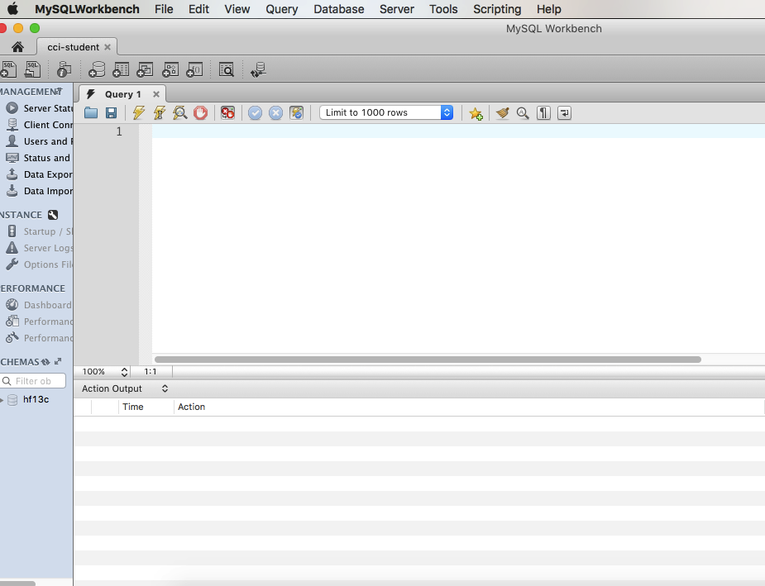
How to Run Premiere SQL (1)
Download the premiere. sql from Canvas: Notes→SQL Resources→Premiere SQL
Open SQL workbench and double-click the CCI-student connection (image below shows the window you should have after the double-click)

Slide 20
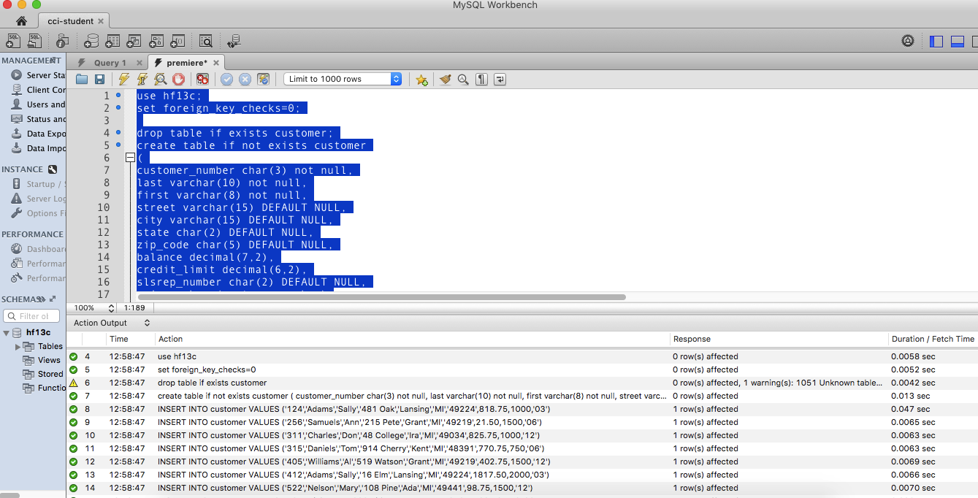
How to Run Premiere SQL (2)
Use File→Open SQL script to load premiere. sql
In the new premiere Window, add one line before set foreign_key_checks=0: use yourfsuid;
Select all text and click the execute icon;

Slide 21
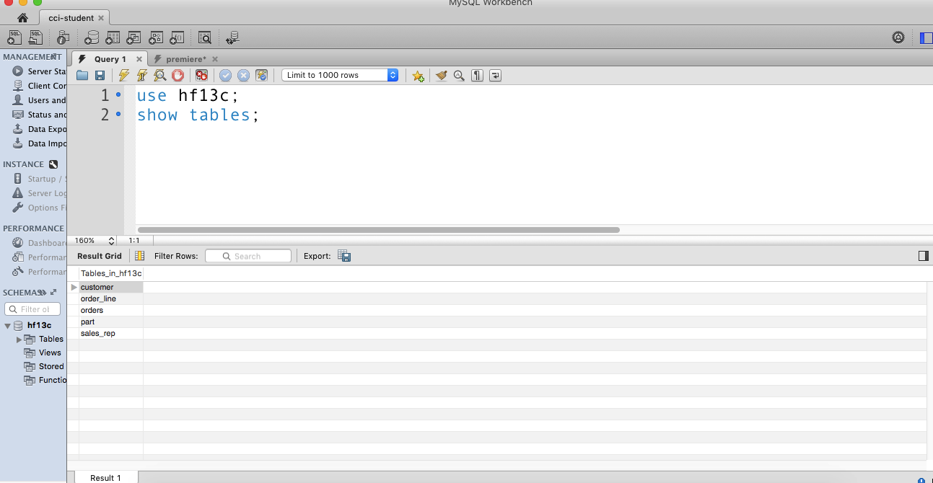
How to Run Premiere SQL (3)
Go back to the Query 1 Window and Run the query:
use yourfsuid;
show tables;
then you should be able to see the five tables and run the queries for assignment 1

Slide 22
Data Query Language (DQL) The SQL SELECT Statement
The fundamental framework for an SQL query is the SQL SELECT statement.
SELECT {ColumnName(s)}
FROM {TableName(s)}
WHERE {Optional Condition(s)}
All SQL statements end with a semi-colon (;).

Slide 23
SELECT
SELECT…FROM…statement
SELECT: Lists the columns that are to be returned in the results
FROM: Lists the tables or views from which data is to be selected
▪▪ List everything in a table
SELECT *
FROM table name;
▪▪ Limit columns to display
SELECT column1_name, column2_name FROM table_name;
▪▪ Sort results
SELECT column1_name, column2_name FROM table_name
ORDER BY column1_name ASC or DESC;

Slide 24
SELECT (Cont’d)
WHERE clause
Provides conditions for the selection of rows in the results
SELECT column1_name, column2_name FROM table_name
WHERE column3_name = 32306 ORDER BY column1_name;

Slide 25
Data Manipulation Language (DML) INSERT INTO
INSERT INTO
Insert new records in a table
Syntax
Implicit INSERT
(*Not stating what columns we want the values to be inserted into)
INSERT INTO tablename VALUES (first_value,...last_value);
Explicit INSERT
(*Instruct SQL which fields you want to insert data into)
INSERT INTO tablename (column_A, column_B, column_C) VALUES (first_value, second_value, third_value);
Examples
INSERT INTO employee (first, last, age, address, city, state)
VALUES ('Luke', 'Duke', 45, '2130 Boars Nest', 'Hazard Co', 'Georgia');
Notes:
Note that it begins with the keywords INSERT INTO followed by the name of the table in which we want to add this new row of data. And then we have an open parenthesis
and a comma separated list of attribute names followed by a close parenthesis.
Note: If we want to add non-numeric data such as text into one of the columns in the table, we must enclose that value in single quotes.

Slide 26
UPDATE
UPDATE
Update or change records that match a specified criteria
Syntax
UPDATE table_name
SET column1_name = “newvalue”
WHERE column2_name = “existingvalue”;
Examples
(A) UPDATE phone_book
SET area_code = 850
WHERE prefix = 979;
(B) UPDATE phone_book
SET area_code = 850;
what is the difference between A and B?
Notes:
UPDATE allows us to alter or modify the values of an existing row or set of rows within a table.
In this example, we're telling the database that I want to change a value in the phone_book table.
I want to change the area core to 850. And I want to make that change only for the row in the table which has prefix equal to 979.
It would set the are_code to 850 for every phone_book.

Slide 27
DELETE
DELETE
Delete records from the table
Syntax
DELETE FROM table_name WHERE columnname = “value”;
Examples
DELETE FROM employee WHERE lastname = 'May';

Slide 28
Data Definition Language (DDL) DROP TABLE/DATABASE
DROP TABLE
To delete a table
Syntax
DROP TABLE table_name
DROP DATABASE
To delete a database
Syntax
DROP DATABASE database_name

Slide 29
CREATE DATABASE
CREATE DATABASE
To create a database
Syntax
CREATE DATABASE dbname;

Slide 30
Aliases
Used to temporarily rename a table or a column
Syntax
SELECT column_name AS alias_name
FROM table_name;
Examples
SELECT CustomerName AS Customer FROM Customers;

Slide 31
SQL commands
SELECT: http://www.w3schools.com/sql/sql_select.asp
INSERT INTO: http://www.w3schools.com/sql/sql_insert.asp
UPDATE: http://www.w3schools.com/sql/sql_update.asp
DELETE: http://www.w3schools.com/sql/sql_delete.asp
ORDER BY: http://www.w3schools.com/sql/sql_orderby.asp
WHERE: http://www.w3schools.com/sql/sql_where.asp
AS (Aliases): http://www.w3schools.com/sql/sql_alias.asp

